Slide 1

How hot is it?
TO BE REPLACED BY FURNACE IMAGE
Julian L. Schmehr, Michael Aling, Eli Zoghlin, Stephen D. Wilson; High-pressure laser floating zone furnace. Rev. Sci. Instrum. 1 April 2019; 90 (4): 043906. https://doi.org/10.1063/1.5085327

Slide 2
How hot is it?
Crystal growths are temperature sensitive
How hot is the molten zone?

Slide 3
How hot is it?
Crystal growths are temperature sensitive
How hot is the molten zone?

Slide 4
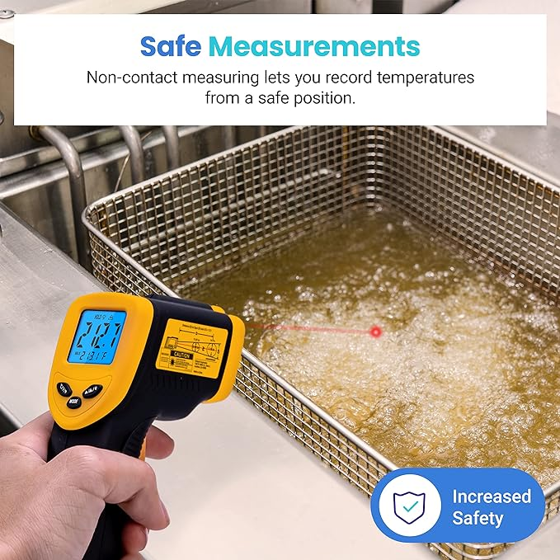
Etekcity Infrared Thermometer Temperature Gun 774, Digital IR Temp Gun for Food, Cooking, BBQ, Pizza Oven, Reptile, Griddle Accessories, Non Contact Surface Outdoor Heat Gun

Slide 5
Pyrometry: Temperature from Radiation

Slide 6
Pyrometry: Temperature from Radiation
Infrared Pyrometers:
Infrared radiation -> temperature

Slide 7
Pyrometry: Temperature from Radiation
Infrared Pyrometers:
Infrared radiation -> temperature

Slide 8
But…
<problem with IR pyrometer>

Slide 9
Measuring more than Infrared

Slide 10
Measuring more than Infrared
Traditional camera

Slide 11
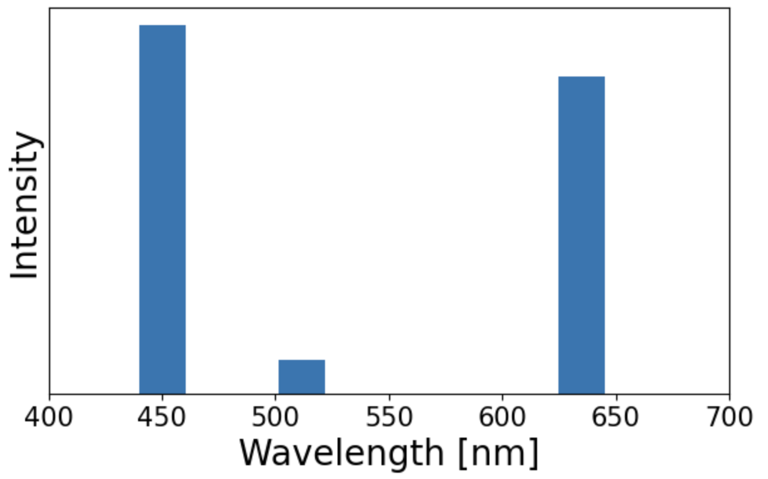
Measuring more than Infrared
Traditional camera

Slide 12

Measuring more than Infrared
Traditional camera

Slide 13
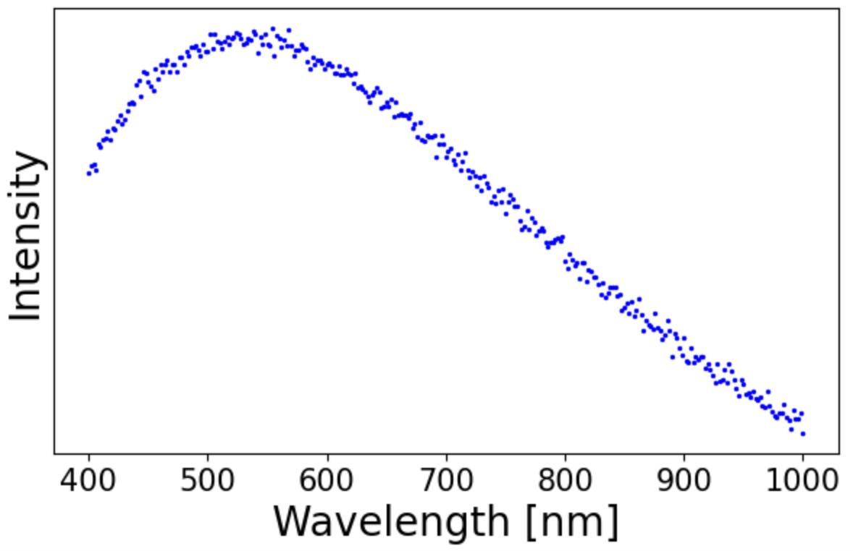
Measuring more than Infrared
Hyperspectral camera

Slide 14
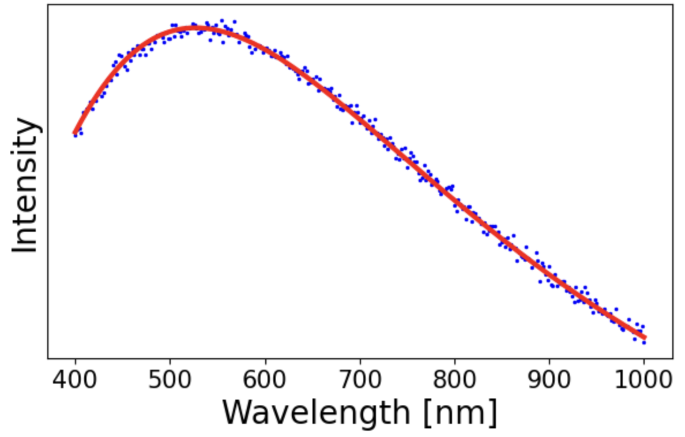
Measuring more than Infrared
Hyperspectral camera

Slide 15
Measuring more than Infrared
Hyperspectral camera
5500 K

Slide 16
Camera mount and setup

Slide 17
Fitting to a Blackbody

Slide 18
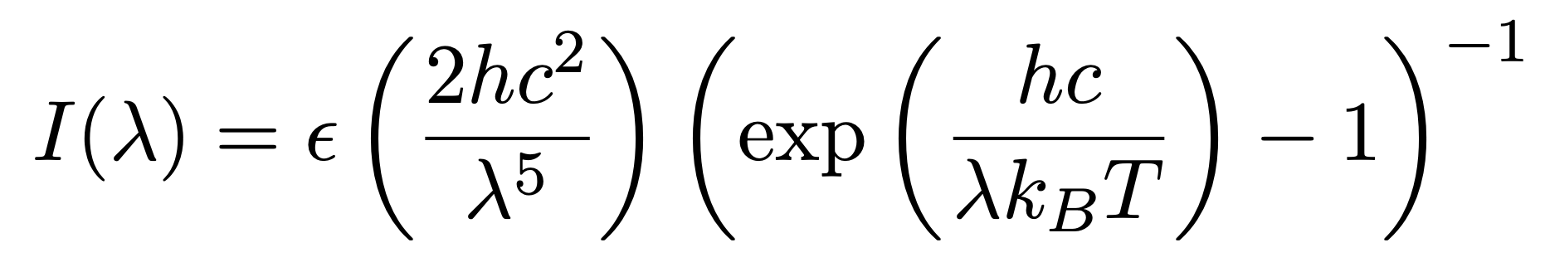
Fitting to a Blackbody

Slide 19
Fitting to a Blackbody
ε: emissivity
T: temperature (what we want!)

Slide 20
Fitting to a Blackbody
ε: emissivity
T: temperature (what we want!)

Slide 21
Fitting to a Blackbody
ε: emissivity is wavelength dependent
T: temperature (what we want!)
Notes:
Everything needs to be either constant, wavelength, or fitting parameter – so we need a function form for emissivity

Slide 22
ε: emissivity is wavelength dependent

Slide 23
ε: emissivity is wavelength dependent
Wavelength dependence is material dependent

Slide 24
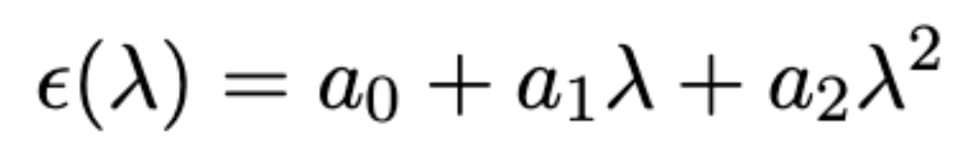
ε: emissivity can be approximated

Slide 25
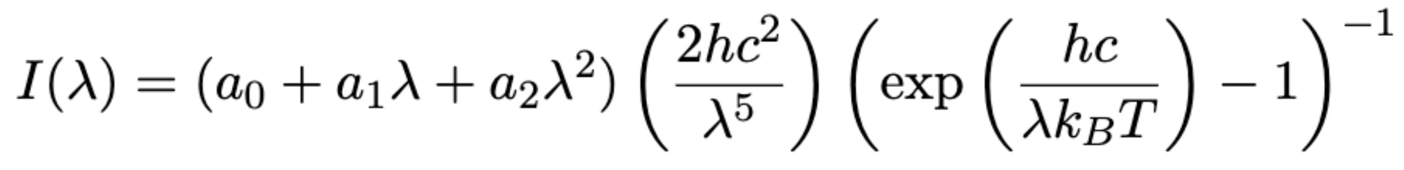
Fitting to a Blackbody
ε: emissivity: problem solved!
T: temperature (what we want!)
Notes:
Everything needs to be either constant, wavelength, or fitting parameter – so we need a function form for emissivity

